Slide 1
Lecture 16
Path finding using dynamic programming
EECS-214

Slide 2
All points shortest-path
Dijkstra’s algorithm is cool, but what if you need to do a lot of route finding in the same graph?

Slide 3
Memoizing
One thing you could do is to save the shortest paths as you compute them
  E.g. in a hash table
Then reuse the saved path if you have to solve the same problem again
This is called memoizing
  Or sometimes caching (although that usually means something a little different)
ShortestPath(a, b)
if (a/b already in table)
return table[a, b]
else
path = dijkstra(a, b)
table[a, b] = path
return path

Slide 4
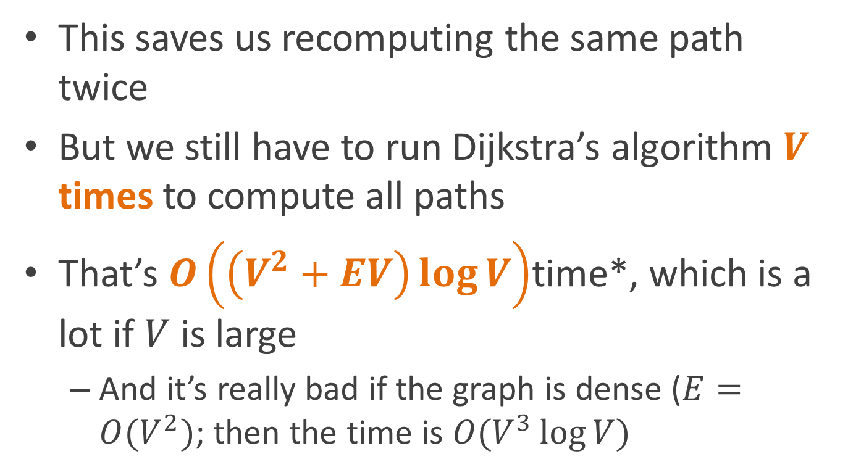
Can we do better?
This saves us recomputing the same path twice
But we still have to run Dijkstra’s algorithm $V$ times to compute all paths
That’s $O\left(\left(V^{2}+EV\right)\log{V}\right)$time*, which is a lot if $V$ is large
  And it’s really bad if the graph is dense ($E=O(V^{2})$; then the time is $O(V^{3}\log{V})$
* Assuming $E>V$, $EV>V^{2}$, so $V^{2}=O(VE)$, and so $V^{2}+EV=O\left(VE\right)$

Slide 5
Shortest paths contain other shortest paths
The shortest path from A to B
  Has to start with A
  Go through some (possibly empty) set of intermediate nodes
  And end with B
If some intermediate node C on the shortest path, then the path is just:
  The shortest path from A to C
  Followed by the shortest path from C to B

Slide 6
Paths within paths
So in finding the shortest path from A to B,
  We’re implicitly finding the shortest paths from A to C and C to B
  We’re re-solving the same problems repeatedly
We’d like some way of memoizing this work so we don’t have to resolve the same problems

Slide 7
Restating what we already said
For any nodes A, B, and C
Either the shortest path from A to B is:
  The shortest path from A to C followed by the shortest path from C to B
  Or the shortest path from A to B doesn’t go through C

Slide 8
And restating it again..
ShortestPath(A,B) =
ShortestPathNotUsingC(A,C) followed by ShortestPathNotUsingC(C,B)
Or ShortestPathNotUsingC(A,B)
Whichever is shorter
(where “not using C” means “not using C as an intermediate node”)

Slide 9
Why do we care?
We just described
  The shortest path between two points
  In terms of shortest paths not using some other node (C)
We can recurse
  Describe shortest paths not using C
  In terms of shortest paths not using C or D (for some D)

Slide 10
Why do we care?
We can recurse:
  Describe shortest paths not using C
  In terms of shortest paths not using C or D (for some D)
And we keep recursing
  Until we describe paths in terms of shortest paths not using any intermediate nodes
  i.e. they’re just edges (easy to compute)

Slide 11
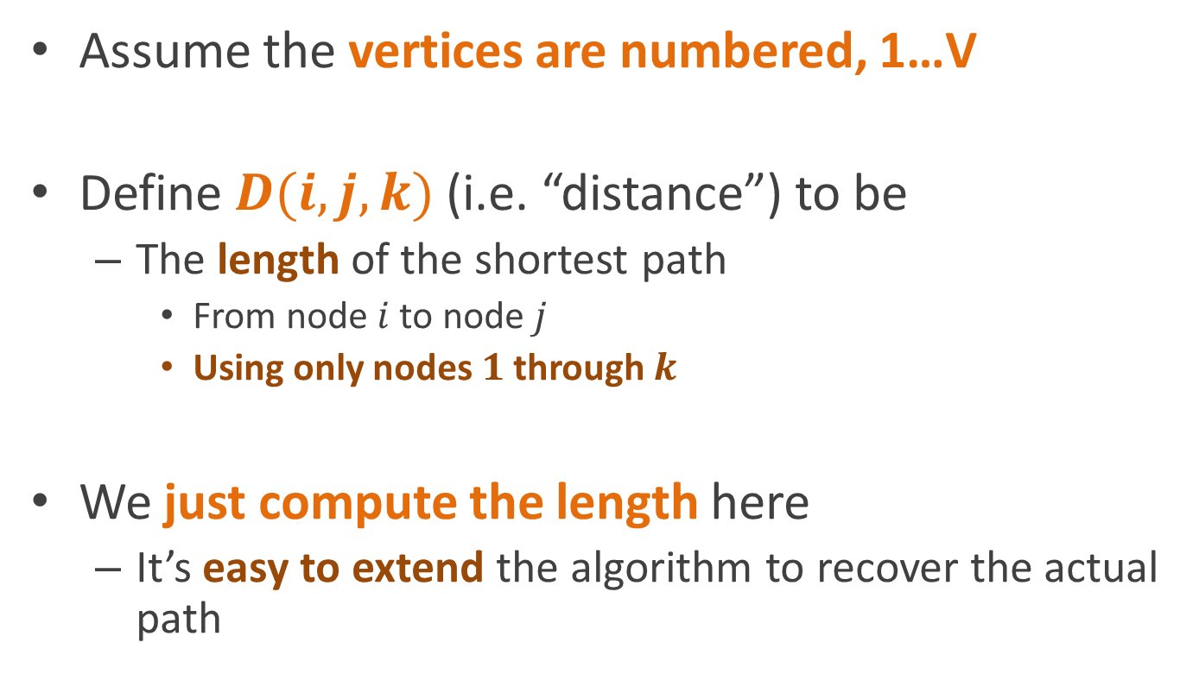
The Floyd-Warshall Algorithm
Assume the vertices are numbered, 1…V
Define$D(i,j,k)$ (i.e. “distance”) to be
  The length of the shortest path
    From node $i$ to node $j$
    Using only nodes $1$ through $k$
We just compute the length here
  It’s easy to extend the algorithm to recover the actual path

Slide 12
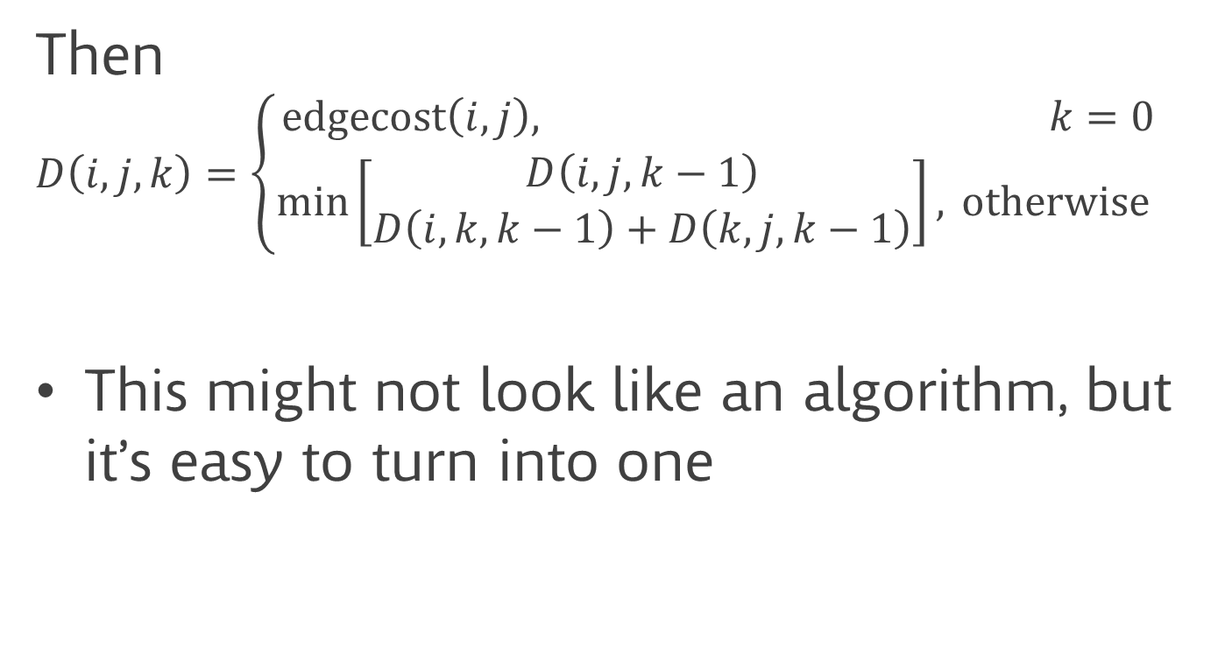
The Floyd-Warshall Algorithm
Then
$$D\left(i,j,k\right)=\left\{\begin{aligned}\text{e}\text{dgecost}\left(i,j\right)\text{, } k=0 \\ \min\left[\begin{matrix}D\left(i,j,k−1\right) \\ D\left(i,k,k−1\right)+D\left(k,j,k−1\right)\end{matrix}\right], \text{otherwise} \end{aligned}\right.$$
This might not look like an algorithm, but it’s easy to turn into one

Slide 13
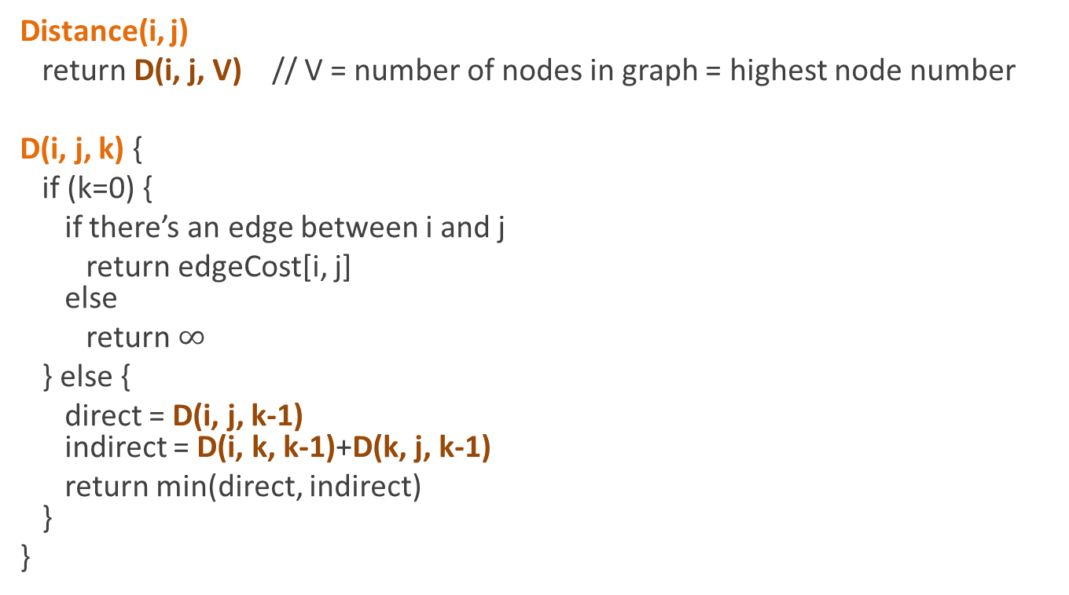
The Floyd-Warshall Algorithm
(bad version)
Distance(i, j)
return D(i, j, V) // V = number of nodes in graph = highest node number
D(i, j, k) {
if (k=0) {
if there’s an edge between i and j
return edgeCost[i, j]
else
return $∞$
} else {
direct = D(i, j, k-1)
indirect = D(i, k, k-1)+D(k, j, k-1)
return min(direct, indirect)
}
}

Slide 14
weren’t we supposed to trying to memoize this computation?
uhhh....

Slide 15
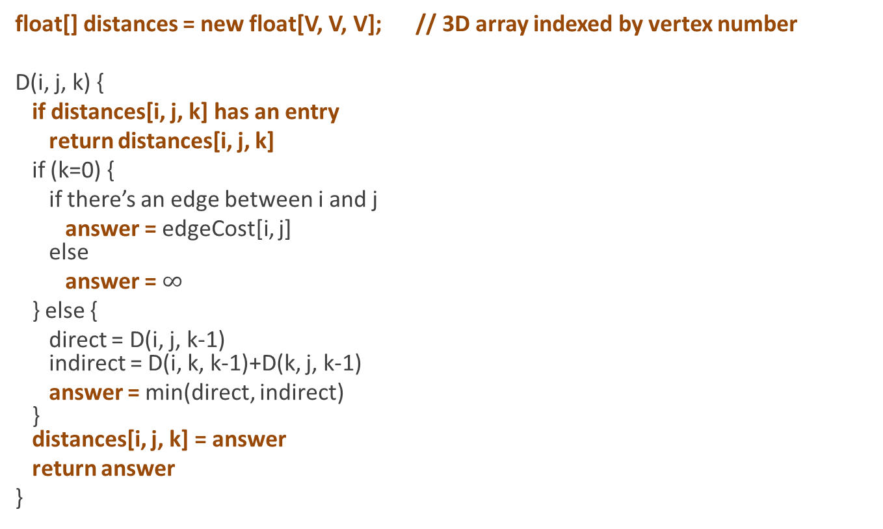
The Floyd-Warshall Algorithm
(space-hungry version)
float[] distances = new float[V, V, V]; // 3D array indexed by vertex number
D(i, j, k) {
if distances[i, j, k] has an entry
return distances[i, j, k]
if (k=0) {
if there’s an edge between i and j
answer = edgeCost[i, j]
else
answer = $∞$
} else {
direct = D(i, j, k-1)
indirect = D(i, k, k-1)+D(k, j, k-1)
answer = min(direct, indirect)
}
distances[i, j, k] = answer
return answer
}

Slide 16
weren’t we supposed to trying to compute all distances at once?
uhhh....

Slide 17
And now the cleverness…
We compute all the different D(i, j, k) values
But we only care about the ones where k=V
  i.e. where k is the number of vertices
  i.e. where we’re allowed to use all the vertices
Once we compute all the values for k, we don’t care about the k-1 values

Slide 18
The real Floyd-Warshall algorithm
Compute D(i, j, 0) for all i, j
Compute D(i, j, 1) for all i, j
  Throw away the D(i, j, 0) values
Compute D(i, j, 2) for all i, j
  Throw away the D(i, j, 1) values
…
Compute D(i, j, V) for all i, j
  Throw everything else away

Slide 19
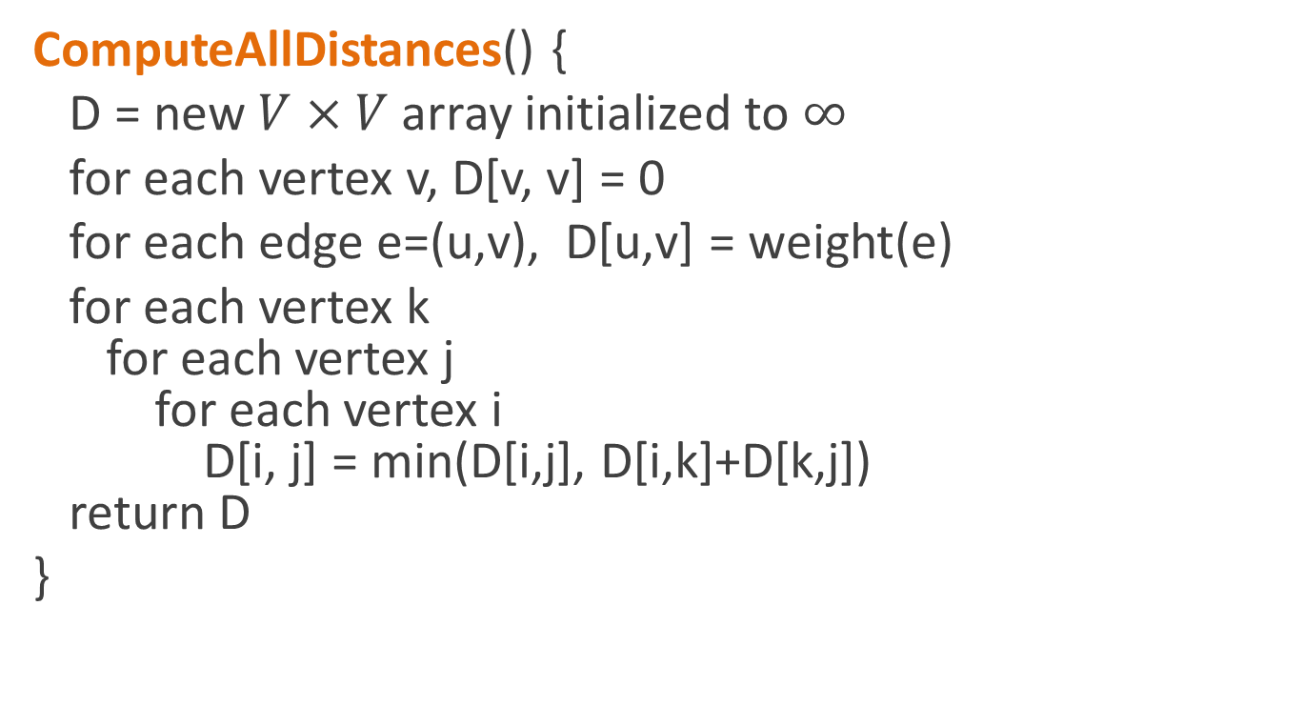
The real Floyd-Warshall algorithm
ComputeAllDistances() {
D = new $V×V$array initialized to $∞$
for each vertex v, D[v, v] = 0
for each edge e=(u,v), D[u,v] = weight(e)
for each vertex k
for each vertex j
for each vertex i
D[i, j] = min(D[i,j], D[i,k]+D[k,j])
return D
}

Slide 20
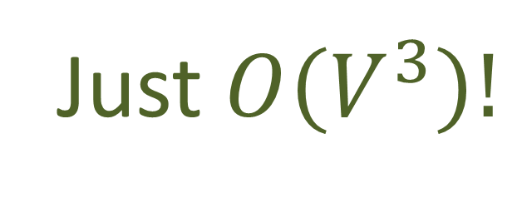
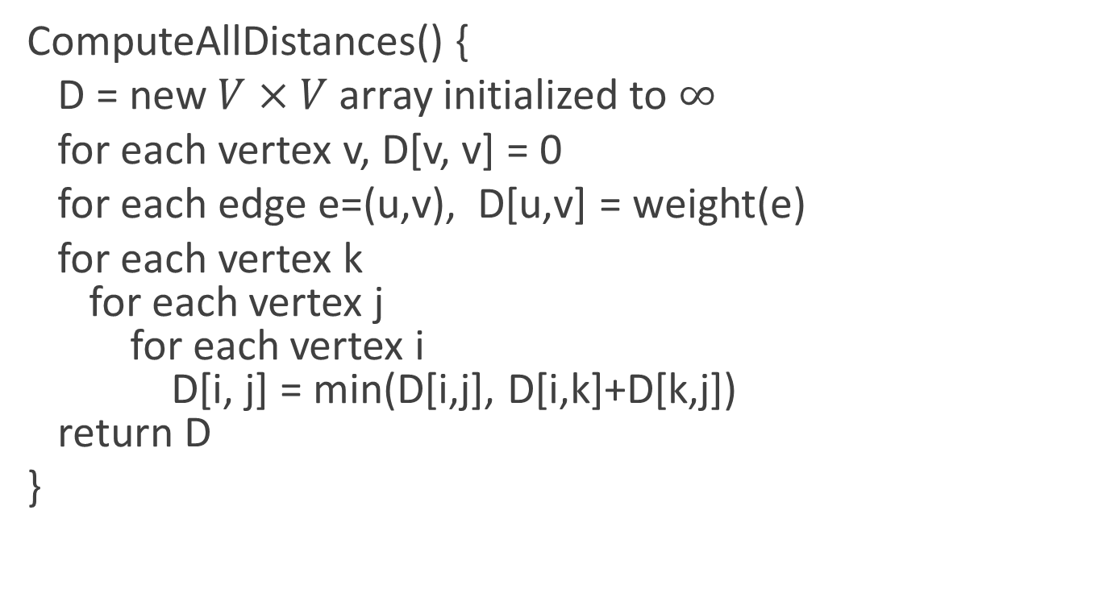
The real Floyd-Warshall algorithm
ComputeAllDistances() {
D = new $V×V$array initialized to $∞$
for each vertex v, D[v, v] = 0
for each edge e=(u,v), D[u,v] = weight(e)
for each vertex k
for each vertex j
for each vertex i
D[i, j] = min(D[i,j], D[i,k]+D[k,j])
return D
}
Just $O\left(V^{3}\right)!$

Slide 21
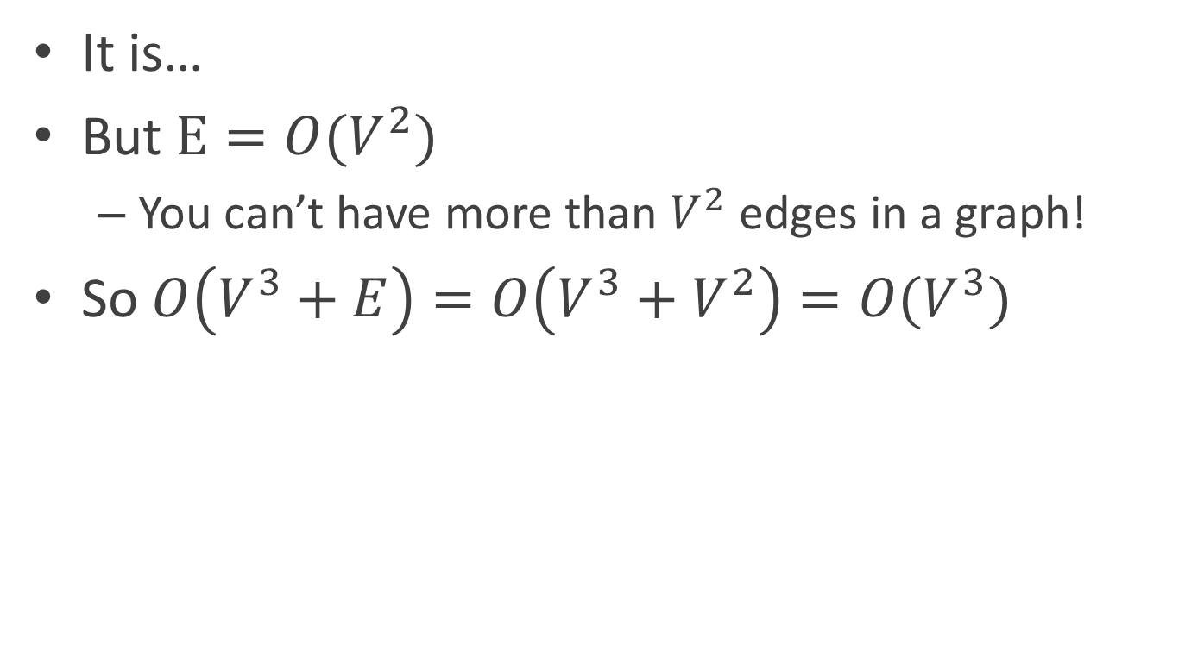

Wait, why isn’t it $O(V^{3}+E)$?
It is…
But $E=O(V^{2})$
  You can’t have more than $V^{2}$ edges in a graph!
So $O\left(V^{3}+E\right)=O\left(V^{3}+V^{2}\right)=O(V^{3})$

Slide 22
Dynamic programming
Dynamic programming is the technique of
  Optimizing algorithms
  By avoiding re-solving subproblems
  By storing and reusing the results of subproblems
Can be as simple as just memozing a recursion
  Sometimes called top-down dynamic programming
  Main problem → subproblems
But it can also involve cleverly rearranging the subproblems so it doesn’t even look like a recursion anymore
  Subproblems → main problem(s)
    Like Floyd-Warshall
  Called bottom-up dynamic programming

Slide 23
Classic algorithm design techniques
Divide and conquer
  Solve problem using subproblems
  Example: binary search
Dynamic programming
  Store and reuse solutions to subproblems
  Example: Floyd-Warshall
Randomization
  Avoid unlikely worst-case behavior
  Example: randomized quicksort
Amortized analysis (next)
  Provide good bounds on efficiency of sequences of calls
  Even if individual calls might be slow
Probabilistic methods
  Very likely produce the right answer
Greedy optimization
  Globally optimal set of choices from locally optimal individual choices
Approximation
  Answers that are provably close to optimal

Slide 24
Reading
CLR chapter 25.1-25.2

